Slide 1
SUDOKU SOLVER
Raj Kumar - 140110088
Akhil Sai -14D170028
Om Prakash -140110083
Kartik Sahu -14D110018

Slide 2
Problem Statement
To solve sudoku puzzle if solution exists.
To make it easy for user to solve a sudoku.
Make a small demo game for user to play.

Slide 3
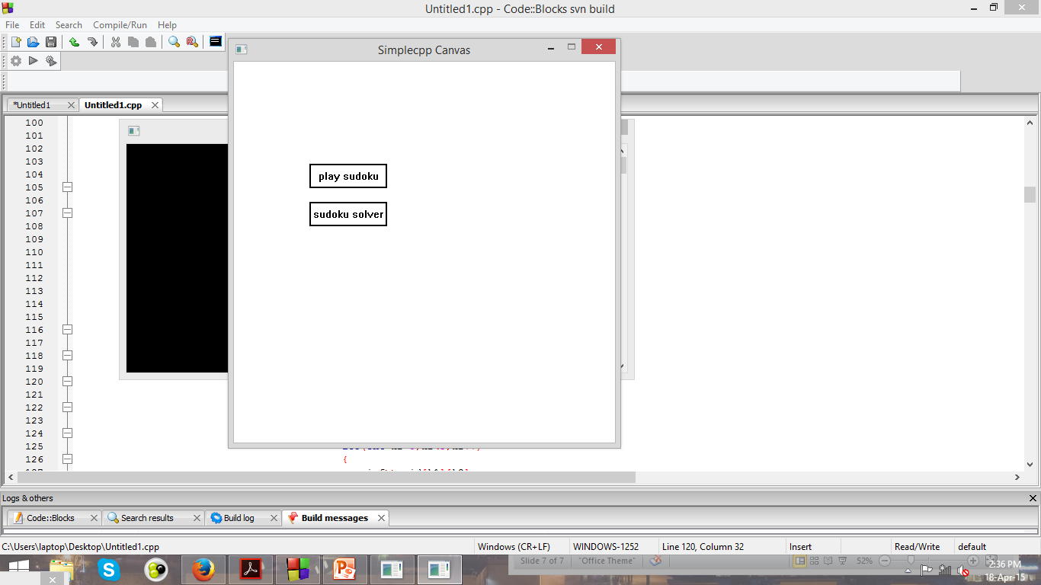

Slide 4
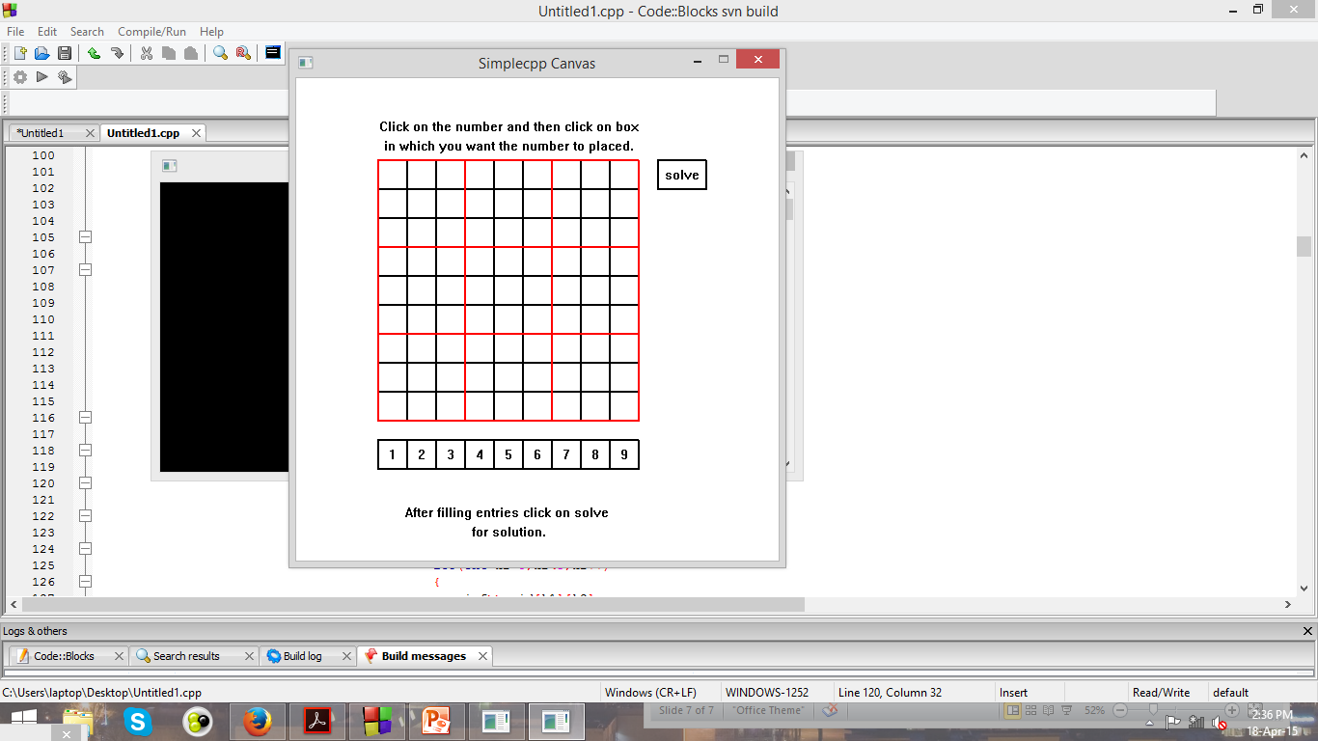
Before giving input

Slide 5
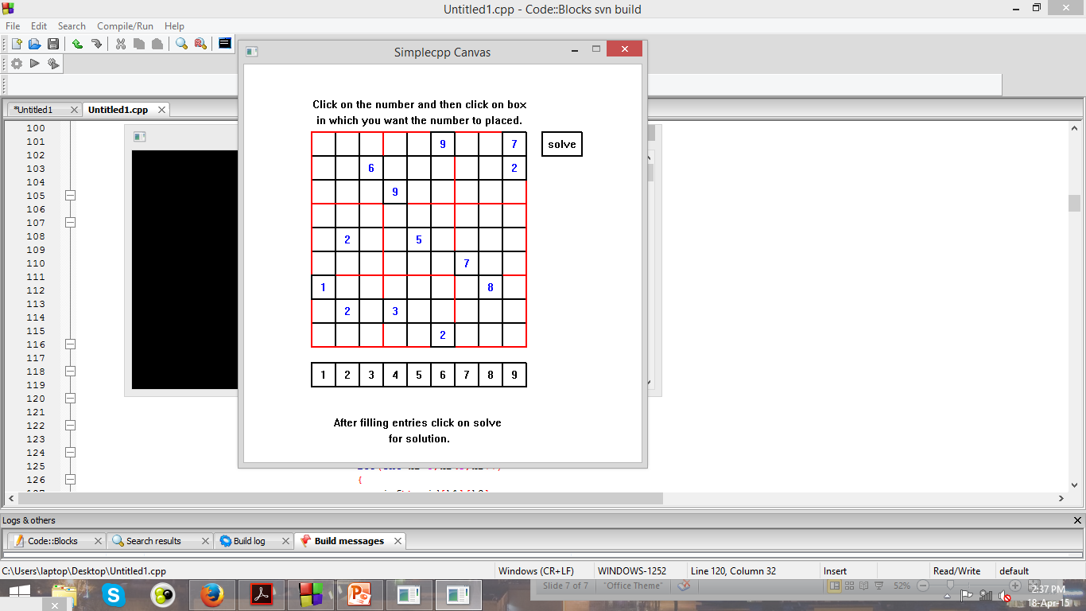
After the input from user

Slide 6
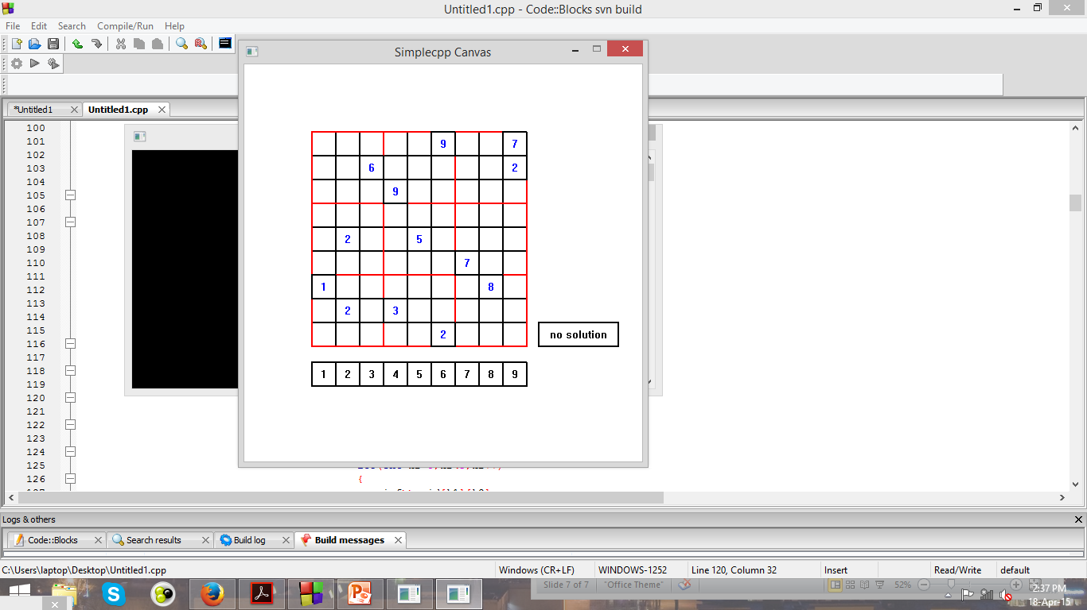
If solution does not exist

Slide 7
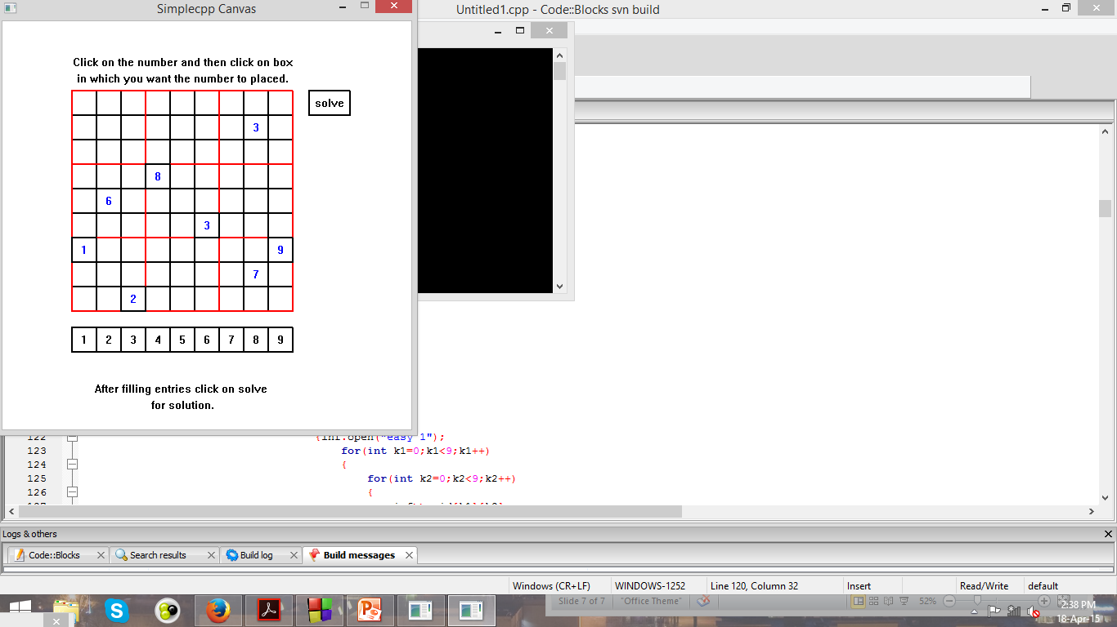

Slide 8
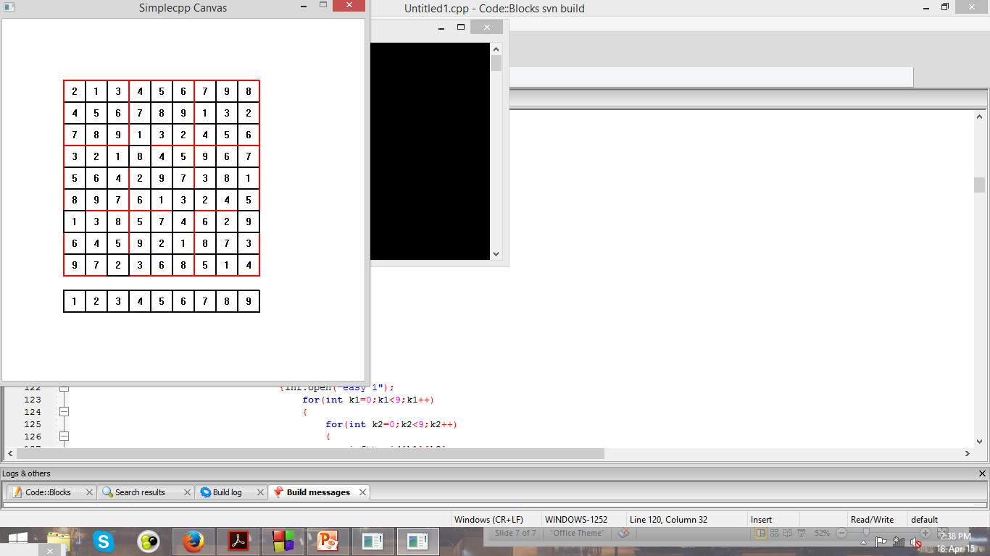

Slide 9
If u wish to play

Slide 10
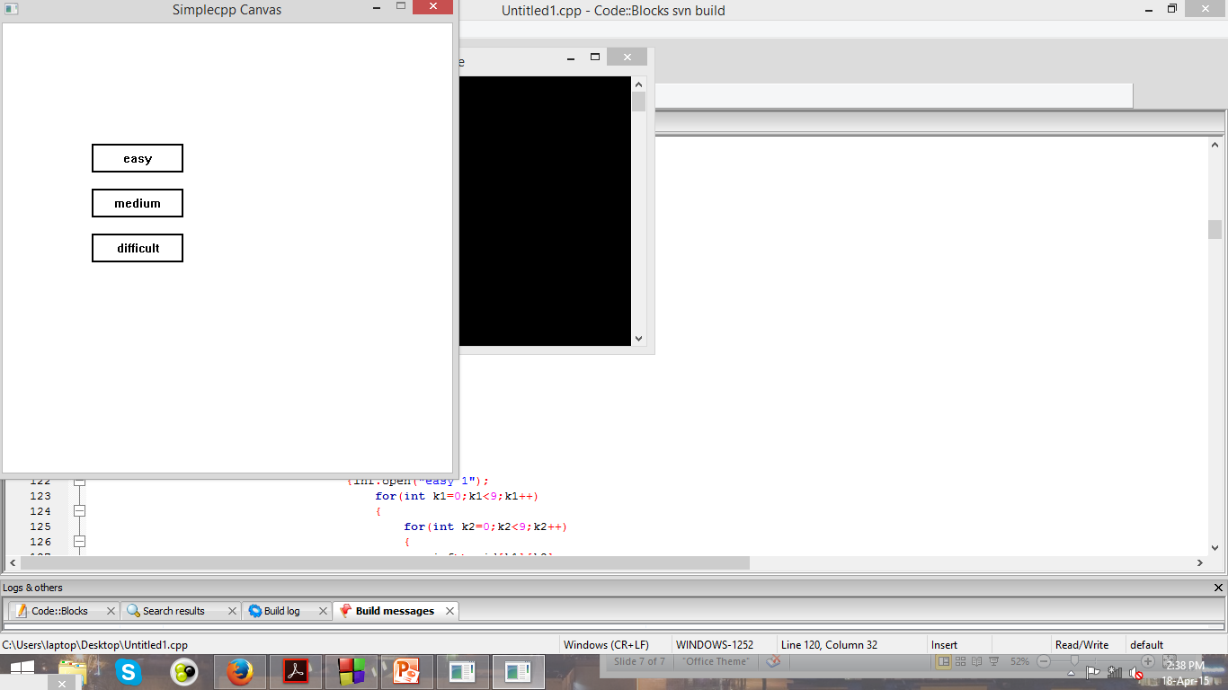

Slide 11
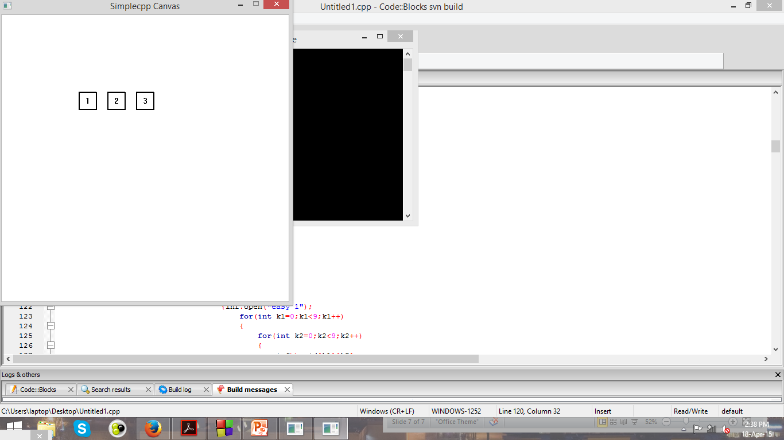

Slide 12
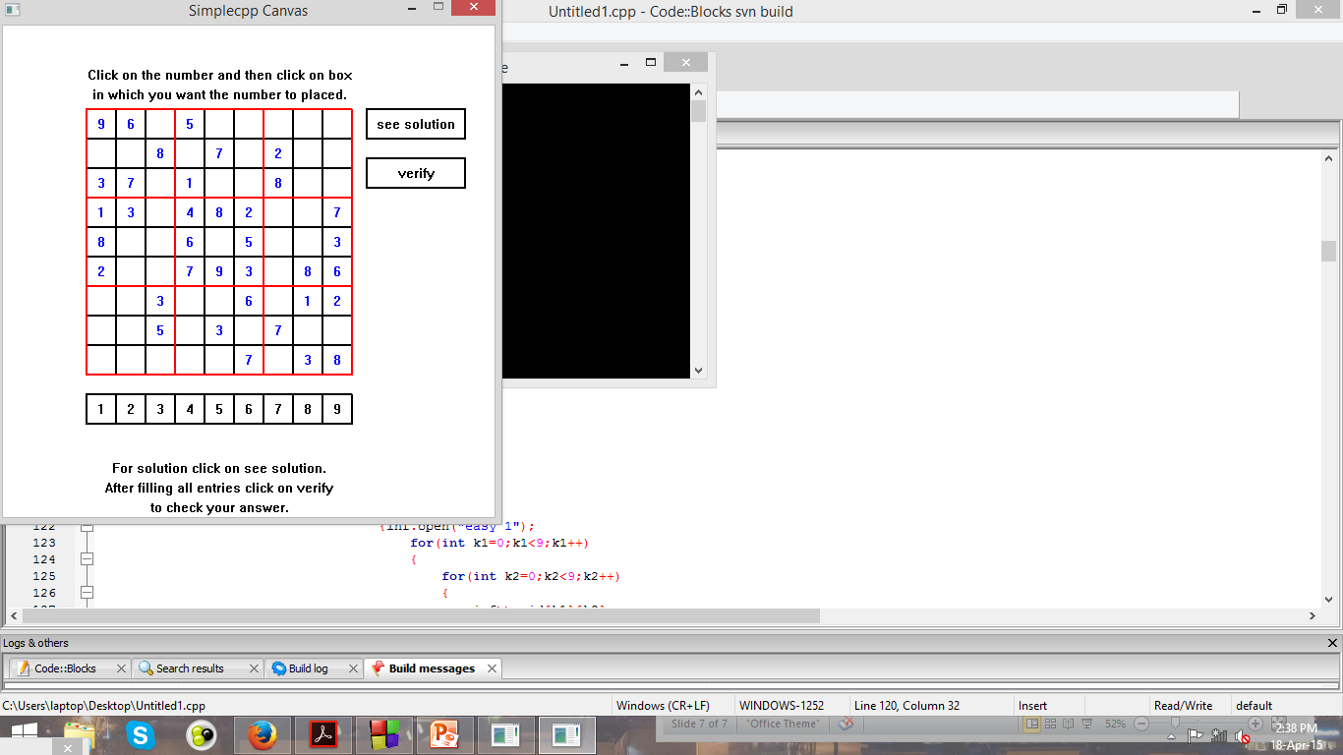

Slide 13
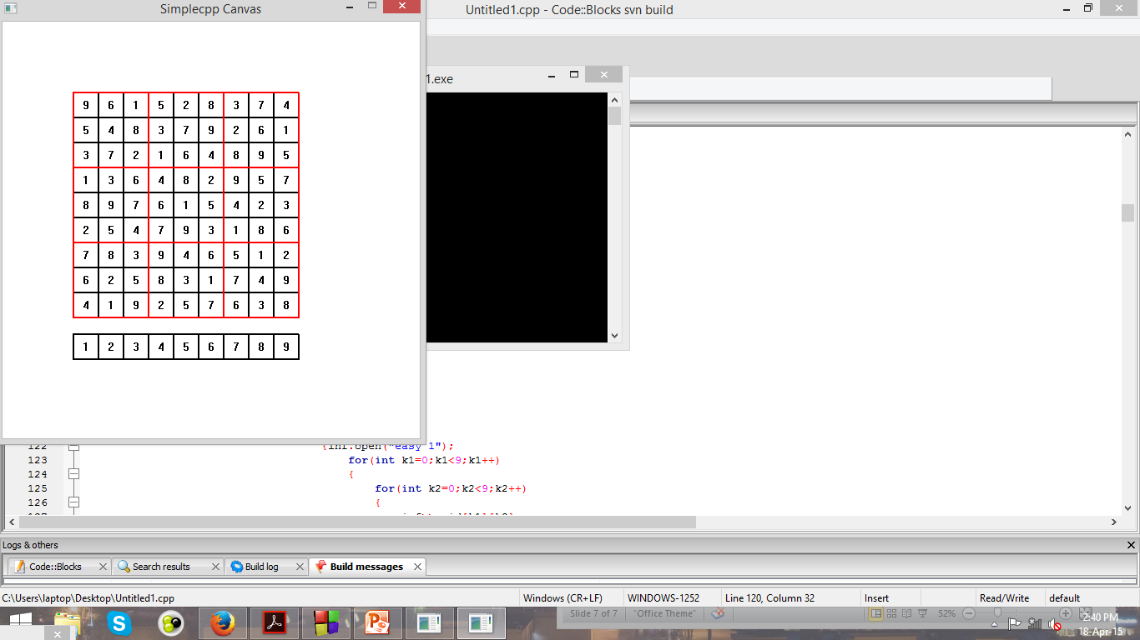

Slide 14
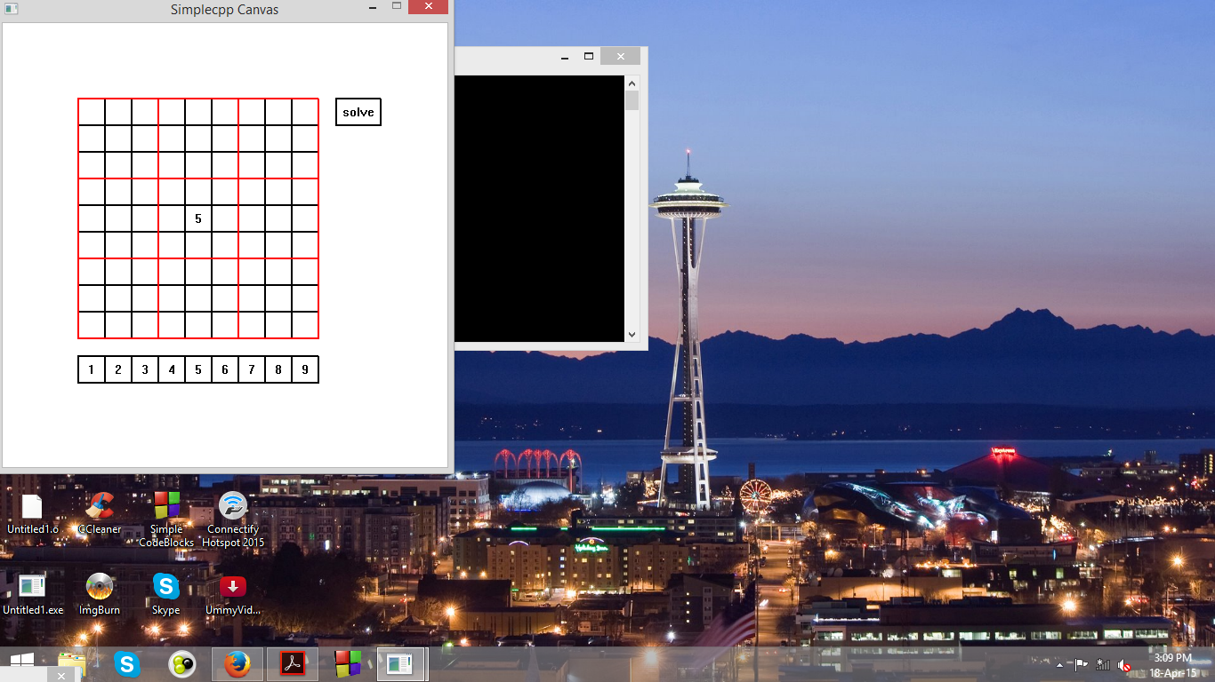
Challenge
While merging both graphical and algorithm part the corresponding input from user exceeded the array size and resulted in segmentation fault.

Slide 15
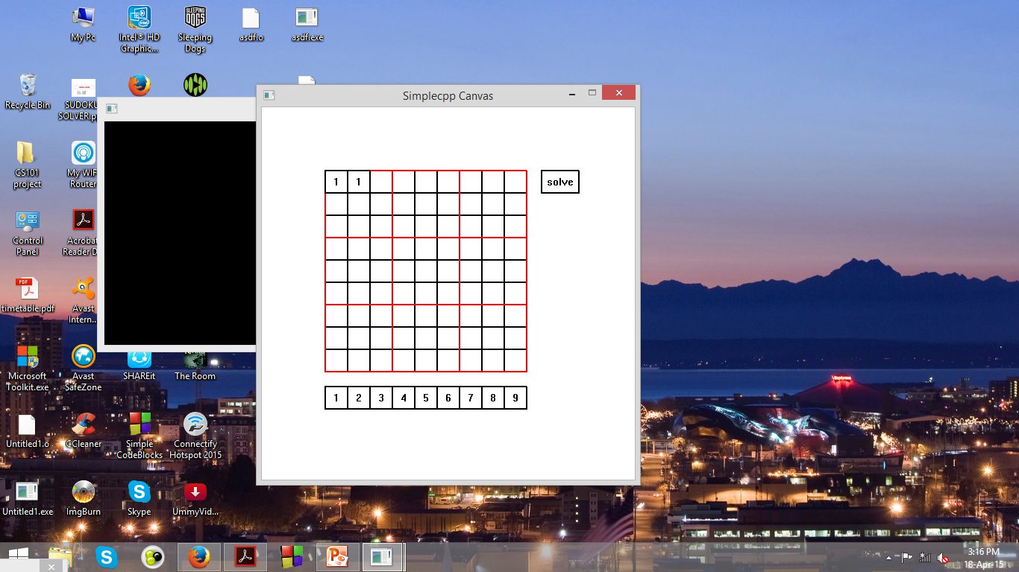
Challenge
If sudoku can’t be solved then the program stops responding to user.
We made some changes in our algorithm and placed a function to print out that it can’t be solved,so that user can know that there is no solution.

Slide 16
Future Work
To save many sudoku puzzles which can be solved. These saved puzzles can be used to build a full sudoku game by making some changes in the algorithm.
To obtain multiple solutions for a given sudoku puzzle if exists.

Slide 17
Thank You

